Slide 1
The three eras of global inequality, 1820-2020 with the focus on the past thirty years
Branko Milanovic
All seasons 2023-4

Slide 2
“the past always counts [because] the inequality of the world is the result of structural realities at once slow to take shape and slow to fade away.”
Fernand Braudel

Slide 3
La longue durée The definition of the three long-run periods (“ages”) from the Industrial Revolution until today

Slide 4
1820-1980 modified and recalculated Bourguignon-Morrisson; 1992-2013: Lakner and Milanovic with extensions, >2013, Milanovic (2022)
History/thepast.xls

Slide 5
Between-country and within country component of Theil (0) : Global income distribution
thepast.xls

Slide 6
Population-weighted between-country convergence is the driver of lower global inequality
Global inequality
Based on household surveys
Between-country inequality
Based on GDP pc
Wendy_ineq_glob.xls

Slide 7
The past thirty years in the world: the greatest reshuffle of individual income positions since the Industrial Revolution

Slide 8
defines.do in interyd/dofiles….

Slide 9
The emergence of the global median or middle class
twoway (kdensity loginc_11_11 [w=popu] if loginc_11_11>2 & bin_year==1988 & mysample==1, bwidth(0.14)) (kdensity loginc_11_11 [w=popu] if loginc_11_11>2 & bin_year==2008 & mysample==1, bwidth(0.14) title("Global income distribution in 1988, 2008 and 2018")) (kdensity loginc_11_11 [w=popu] if loginc_11_11>2 & bin_year==2018 & mysample==1, bwidth(0.2) lwidth(thick)) , legend(off) xtitle(log of annual PPP real income) ytitle(density) text(0.78 2.5 "1988") text(0.8 3.3 "2008") text(0.72 3.6 "2018") xlabel(2.477"300" 3"1000" 3.477"3000" 4"10000" 4.699"50000", labsize(small) angle(90))
Using combine88_18_deciles.dta“
Using \final18_china_lis.dta

Slide 10
How to measure it?
Conversion of local currency income into Measure of inequality | International dollars | US dollars at market exchange rate
Relative | A Compares welfare Most common approach | B Compares ability to purchase internationally-priced goods
Absolute | C Compares welfare Tends to increase with the rise in mean income | D Compares ability to purchase internationally-priced goods

Slide 11
Urban China vs. the United States, 2018 (all in $PPPs)
twoway (kdensity log10inc [w=popu1] if whole==1 & log10inc>2 & contcod=="USA", bwidth(0.14) xlabel(2.477"300" 3"1000" 3.477"3000" 4"10000" 4.699"50000" 5 "100000", labsize(small) angle(90)) area(0.35)) (kdensity log10inc [w=popu1] if mysample==1 & log10inc>2 & contcod=="CHN-U", bwidth(0.14) xlabel(2.477"300" 3"1000" 3.477"3000" 4"10000" 4.699"50000" 5 "100000", labsize(small) angle(90)) xtitle(log of annual per capita PPP income) ytitle(density) legend(off) text(1 3.95 "China-urban") text(0.5 4.48 "USA") xline(3.85, lpattern(dash)) xline(4.36, lpattern(dash)) text(1.4 4.1 "Ratio 3.2") area(0.84)) (scatteri 1.34 3.85 1.34 4.36, recast(line) lwidth(thick))

Slide 12
Core and periphery in 2018 (in PPPs)
Core: WENAO plus Japan; periphery: all others except China
twoway (kdensity log10inc [w=popu1] if mysample==1 & log10inc>2 & rich==1, bwidth(0.14) xlabel(2.477"300" 3"1000" 3.477"3000" 4"10000" 4.699"50000" 5 "100000", labsize(small) angle(90)) area(1.0)) (kdensity log10inc [w=popu1] if mysample==1 & log10inc>2 & rest==1, bwidth(0.14) xlabel(2.477"300" 3"1000" 3.477"3000" 4"10000" 4.699"50000" 5 "100000", labsize(small) angle(90)) xtitle(log of annual per capita PPP income) ytitle(density) legend(off) text(0.92 3.3 "Periphery") text(1.3 4.3 "Core") xline(4.26, lpattern(dash)) xline(3.35, lpattern(dash)) text(4 3.8 "Ratio 8.2") area(4.3)) (scatteri 3.85 3.35 3.85 4.25, recast(line) lwidth(thick))

Slide 13
Core and periphery in 2018 (in dollars at the market exchange rate)
Core: WENAO plus Japan; periphery: all others except China
twoway (kdensity log10_USinc [w=popu1] if mysample==1 & log10inc>2 & rich==1, bwidth(0.14) xlabel(2.477"300" 3"1000" 3.477"3000" 4"10000" 4.699"50000" 5 "100000", labsize(small) angle(90)) area(1)) (kdensity log10_USinc [w=popu1] if mysample==1 & log10inc>2 & rest==1 & USinc>100, bwidth(0.14) xlabel(2.477"300" 3"1000" 3.477"3000" 4"10000" 4.699"50000" 5 "100000", labsize(small) angle(90)) xtitle(log of annual per capita income at market exchange rate) ytitle(density) legend(off) text(0.92 2.8 "Periphery") text(1.3 4.3 "Core") xline(4.23, lpattern(dash)) xline(2.88, lpattern(dash)) area(4.3) text(4 3.6 "Ratio 22.6")) (scatteri 3.85 2.9 3.85 4.23, recast(line) lwidth(thick))

Slide 14
Africa vs. the core, 2018 (all in $PPPs)
twoway (kdensity log10inc [w=popu1] if mysample==1 & log10inc>2 & rich==1, bwidth(0.14) xlabel(2.477"300" 3"1000" 3.477"3000" 4"10000" 4.699"50000" 5 "100000", labsize(small) angle(90)) area(1)) (kdensity log10inc [w=popu1] if mysample==1 & log10inc>2 & region==1, bwidth(0.14) xlabel(2.477"300" 3"1000" 3.477"3000" 4"10000" 4.699"50000" 5 "100000", labsize(small) angle(90)) xtitle(log of annual per capita PPP income) ytitle(density) legend(off) text(0.92 3.3 "Africa") text(1.3 4.3 "Core") xline(4.26, lpattern(dash)) xline(3.15, lpattern(dash)) text(1.4 3.8 "Ratio 12.6") text(1.4 5 "Less than 1%" "of African population" "has income" "above the core median", box margin(small)) area(0.86)) (scatteri 1.34 3.16 1.34 4.23, recast(line) lwidth(thick))
Using \final18_china_lis.dta

Slide 15
The high globalization: 1988-2008 (from the Fall of the Berlin Wall to the Global Financial Crisis)

Slide 16
Real income growth at various percentiles of global income distribution, 1988-2008 (in 2005 PPPs)
High growth of Asian middle classes
High growth of the global top 1%
Low growth of Western middle classes

Slide 17
“The interregnum” Between the financial crisis and covid, 2008-18

Slide 18
After the financial crisis: 2008-13
Continued very strong growth around the global median
No improvement for Western middle classes
Slowdown of growth of the global top 1%
Coverage in 2013: 95% of world population and income
Africa_povcal.xls

Slide 19
Global growth incidence curve 2013-18
(cumulative per capita growth; real 2018 PPPs)
Strong growth on the bottom and middle of global income distribution
Low growth at the top
Coverage in 2018: 97% of world income and 91% of world population

Slide 20
Thus we have the global data for the past 30 years: From the end of communism to the beginning of the new Cold Wars

Slide 21
What has elephant become?
2008-18
1988-2008
All in real PPPs, household per capita income.
Compare_08_18.xls

Slide 22
But absolute real income gains remain strongly pro-rich 2008-18
Compare-08_18.xls

Slide 23
What happened at the bottom of global income distribution, 2008-18?
Lots of Chinese rural population “evacuated” the bottom global quintile: from 200 million in 2008 to 75 million in 2018. This creates more than 125 million of “empty slots” (plus the additional slots due to the rising world population). Poor Chinese deciles grew at an average rate of 10-12 percent over that period.
Who filled the “empty slots”? Primarily, Southern Asia: Bangladesh added 76 million, Pakistan 56 million. Nigeria also too added 50 million to the bottom quintile. The Indian Subcontinent now accounts for more than one-half of all people in the poorest global quintile.
Standard mechanism of relatively high growth among the poor who were in the bottom quintile in both years: Vietnam 12.5% per annum, Ethiopia 8.7%, Ghana 9.8%, Kenya 6.9% etc.

Slide 24
The greatest reshuffling of global income positions since the Industrial Revolution
Rich countries’ lower parts of income distributions shifted down in terms of their global income positions, e.g. their lowest deciles which thirty years ago were (say) at the global 70th percentile are now at the 60th.
The global positions of the upper halves of the rich countries’ income distributions are not affected because the Asian middle classes have not yet entered en masse these high percentiles.
To keep their relative global positions, lower parts of rich countries’ distributions must grow at Asian (or Chinese) growth rates.

Slide 25
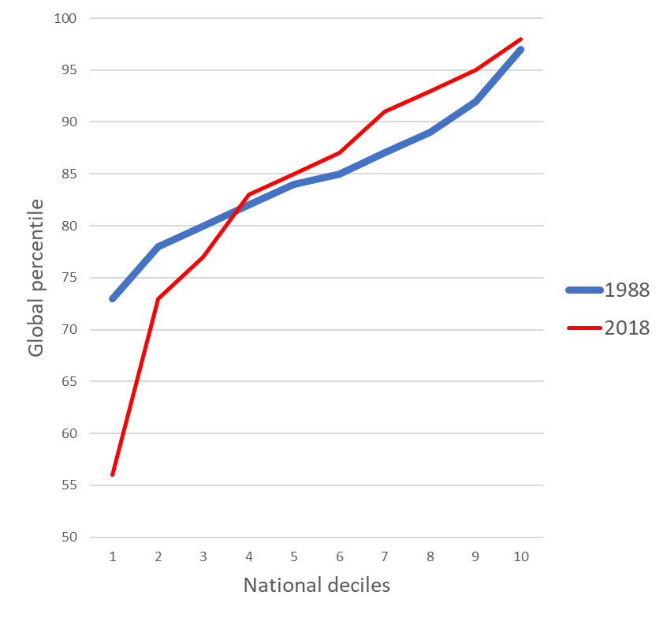
Urban China, 1988 and 2018
Italy, 1988 and 2018

Slide 26
Germany, 1993 and 2018
Poland, 1988 and 2018

Slide 27
United States, 1988 and 2018
Brazil, 1988 and 2018

Slide 29
The global top 1 percent

Slide 30
The global top 1% is still mostly “populated” by the rich from the Western countries
82% of the people in the global top 1% are from western Europe, North America and Oceania.
Countries with the highest share of the global top-1-percenters are
Luxembourg 14%, USA 12%, Hong Kong and Singapore about 10%, and Switzerland 9%.
West European countries: between 3 and 5 percent.
(All data in international per capita dollars).

Slide 31
Composition of the global top five percent in 2008 and 2018 (in %)
Top5%_08_18

Slide 32
The present: the period of big external shocks

Slide 33
The greatest setback to global poverty and inequality reduction since the Second World War.
Figuring out what is happening with global income distribution in real time has become very difficult because of three non-economic discrete shocks that are very broad (affecting many) and statistically hard to grasp and forecast.
The first shock was covid which is still ongoing. It affected inequalities everywhere, but in an uneven way: e,g. inequality in the US declined in 2020 thanks to large gov’t transfers (CARES Act), but in many poor countries it went up.
Unprecedented role of government spending in offsetting the economic effects of the crisis.

Slide 34
The second shock was the US-China trade tensions and their deteriorating economic relations. That shifted some value chains away from China and might have affected inequality in both China and the US negatively. But we do not know empirical effects yet. The shock is still ongoing.
The third shock was the Russia-Ukraine war. If it leads to a nuclear war, that would be the mother of all shocks. But even if it does not, it is affecting Ukraine through destruction, and Russia through severe trade disruption (sanctions). Both countries' incomes will go down in the next years.

Slide 35
But in addition, the third shock will also increase global poverty and inequality via increased food and energy prices that affect poor countries and poor people the most. The share of food and energy in consumption is esp. high for the poor (being at times over 3/4 of all their expenditures).
When one adds all of that, it is clear we are facing the largest setbacks to global poverty and inequality reduction since the end of WW2.

Slide 36
What next for global inequality?
Probable increase of global inequality after 2020.
The ambivalent role of China: it has become upper middle-income country and its growth can no longer drive global inequality down (see the next slide);
substantial income decline in India and hence addition to inequality;
impossibility of predicting growth rates in large African countries.
Our attention shifts from China to Africa.
The basic story is one of unpredictability.

Slide 37
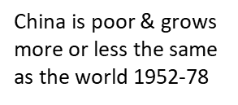
China’s diminishing global equalizing role
China is sufficiently rich that its growth no longer reduces international inequality
Cultural Revolution
The Great Leap Forward
China grows faster and this reduces international inequality, 1978-2020
China_contribution-globalineq.doc in income_inequality/…/twenty-five

Slide 38
The most important probable future developments
For the first time in two centuries, Western middle classes will not be in the global top quintile.
Global top percentiles will be increasing populated by Asians. The change will be substantial and sudden because of Asian population size. Important psychologically because the entire modern period was a period of Western income (and wealth cum military) dominance. Effect on consumption patterns.
Rich Atlantic and Pacific coasts will leave most of the Eurasian landmass (Russia and Central Asia) relatively poor and with low population density.
Huge and possibly increasing Europe-Africa gaps will “feed” migration pressure for a long time. Europe needs to find a solution for that. If China’s BRI helps Africa grow, an unlikely partnership between Europe and China is possible.
But will Africa grow?

Slide 39
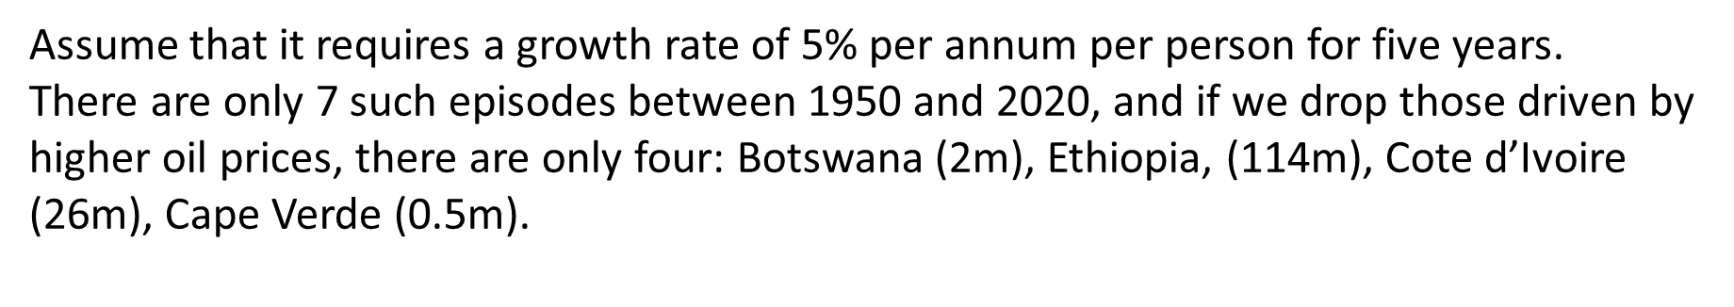
How likely is Africa to grow fast & reduce global inequality? That is, can Africa become a new China?
Country | Period | Number of years
Botswana | 1969-83 | 15
Cote d’Ivoire | 2013-17 | 5
Cape Verde | 1994-98 | 5
Ethiopia | 2005-17 | 13
Gabon | 1962-66 | 5
Gabon | 1970-76 | 7
Eq. Guinea | 1993-2005 | 13

Slide 40
Extras

Slide 41
Reduction of income inequality in the US thanks to large government transfers during covid—but this is a one-off policy
usa86-_20.xls
Calculated from LIS data

Slide 42
Increased urban inequality in China 2020
Whole contries\china\wenjie\Final_results_81_18.xls

Slide 43
China and the USA: Real income increase by quintile, 2019-20
Whole contries\china\wenjie\Final_results_81_18.xls

Slide 44
In terms of between country inequality, the covid shock stopped the convergence that has been going on for the past four decades.
Note that the population-weighted between-country inequality has stabilized in 2020 (the blue line in the next graph is no longer going down).

Slide 45
Market and disposable income inequality in the United States, 1963-2022

Slide 47
defines.do using :\Branko\interyd\Data\gdppppreg10.dta and defnes.dp

Slide 48
Three important methodological issues
Underestimation of top incomes
Instability (and intransitivity) of PPP dollars
Lack of data from India since 2011-12.

Slide 49
Survey vs fiscal data in inequality estimations
Labor, capital and business income among percentiles p91-p95 are almost exactly the same whether we use household surveys or fiscal data.
For percentiles p96-p99, labor income continues to match fiscal data. But for capital income and business income, the gap emerges: capital income is higher in surveys than in fiscal data, business income is lower. This seems to be (in the US) an artifact of how people decide to classify their business income for tax purposes.
For the top 1%, labor income from surveys is about 80% of fiscal labor income. The gap between capital and business income in surveys and fiscal data is very large though: surveys cover only ~20%.
About ¾ of overall survey “underestimation” comes from the lower amounts of capital and business income among the top 1%.

Slide 50
Estimates of labor and capital income among the percentiles 96-99 (survey and tax data; USA)
Labor income
Capital income

Slide 51
Estimates of labor and capital income among the top 1 percent (survey and tax data; USA)
Labor income
Capital income
Large Gap

Slide 52
Instability of PPP estimates
All data should be at 1 if the correct deflator for the PPP numeraire is US inflation. The mean and the median are 1.03, but about 20% of observations fall outside one standard deviation.
From do C:\Branko\Income_inequality\final08\convert_real_2018

Slide 53
India
The latest national-level official consumption data from 2011-12.
The survey from 2017 was withdrawn and officially cancelled after some initial leaks appeared in the press.
There is a good income survey from 2012, but its next “installment” supposed to be for 2017 or 2018 is not yet published
The void has been filled by private, not always methodologically sound surveys, without full national coverage or representativeness.
Unusually large difference between Indian consumption Ginis (around 35-36) and income Ginis (around 50) poses additional problems.

Slide 54
Global incidence curves 1988-08 and 2008-18
Modified consumption data from Roy & Roy
Compare_08_18.xls

Slide 55
Other data and slides

Slide 56
twoway (scatter gini mean if group==1 & region~=1 & mysample==1, mlabel(contcod) xscale(log)) (scatter gini mean if group==1 & region==1 & mean>600, mlabel(contcod) legend(off) xlabel(1000 5000 10000 40000) title(Inequality and mean pc income from hhold surveys 2018))
Using final18_china_lis.dta

Slide 57
Data for 2018
 | Mean per capita income (per year) | Median per capita income (per year) | Mean-median ratio | Gini | Country’s median in global income ranking
European Union | 18,836 | 15,557 | 1.21 | 36.5 | 87
China | 6,965 | 3,697 | 1.88 | 43.8 | 52
China urban | 8,914 | 7,076 | 1.26 | 36.3 | 70
China rural | 3,919 | 3,077 | 1.27 | 40.0 | 46
United States | 30,288 | 22,709 | 1.33 | 41.1 | 93
Russia | 8,610 | 6,459 | 1.33 | 37.5 | 68
India | 2,584 | 1,542 | 1.68 | 51.3 | 29
World | 7,602 | 3,558 | 2.14 | 60.1 | 50

Slide 58
Interyd using defines.do

